Slide 1

INSTITUTE OF AEROUNATICAL ENGINEERING
PROJECT TITLE :
AGRICULTURE SORTER MACHINE

Slide 2
PROJECT BASED LEARNING LABORATORY
UNDER THE DEPARTMENT OF CSE
UNDER THE GUIDANCE OF
Dr C.SHANTAIAH SIR , Associate professor (CSE)
TEAM
19951A05G2 – M.SATHVIK KUMAR
19951A05F8 – V . SANJAY BHARDWAJ
19951A05C9 – P.POOJITH ANAND SAI

Slide 3
Abstract
Multiple Fruit and Vegetable Fruit Sorting System using Machine Vision is presented in this paper. The grading systems were developed for easing the labour intensive work and create consistency in the quality of the product. The current grading systems involved in the fruit sorting cater to only one type of fruit. So by adding more features like fruit and vegetable identification under variable background condition can enhance the quality of the agricultural produce. This paper proposes a technique to achieve multiple fruit and vegetable sorting using fuzzy logic and K-Means clustering method by using a low cost image capturing device.

Slide 4
Introduction
Harvesting and packing is the major portion of the effort and cost by farmers producing fresh fruits and vegetables to market. However, the processing and manufacturing areas require product detection and grading for commercial and production purposes.
Manual sorting and grading are based up on traditional visual quality inspection done by human operators, which is time-consuming, slow and non-consistent. There is continuous growth in the development of mechanical harvesting system, so that the losses during harvesting, production and marketing can be minimized.
A cost effective, consistent, high speed and accurate sorting can be achieved with machine vision sorting and grading. Computer application plays a major role in agriculture and food industries in the areas of sorting, grading of fresh products, and detection of defects such as cracks, dark spots and seeds.​

Slide 5
Separation of fruits is performed primarily by visual inspection using colour as a especial quality attribute. Many industries with capability of large-scale buying and selling of fruits & vegetables, are using image processing technology for sorting motive. But the image processing system of sorting requires very highly developed technology of image capturing and processing which is very costly and not right for small traders.
The proposed sorting system in this offers an economical solution for such grade of automated fruit sorting practices. By dealing with an automated material handling system, it results in dividing the fruits by color . There by the prosy work done by human is eliminated, acquiring accuracy and speed in the work. This sorting method presents a precise, safe, consistent and quantitative sorting technique for sorting based on color . Automated sorting system not only speeds up the time of the process but also decrease fault​s .

Slide 6
AIM AND OBJECTIVE
This project aims to reduce the manual work while sorting and grading so that work can be done simply and precisely by which farmers can reduce the damage while sorting.
The main objective is to design an automated machine which help the farmers in sorting the fruits or vegetables this increase the rate of sorting

Slide 7
Need Statement
Agriculture needs a lot of man work. It consumes a lot of time for the farmers for manual sorting and examining of fruits from harvest till its growth period. Manual sorting doesn’t give adequate results every time, so it needs an efficient smart farming techniques which can used to get better yield and growth with less human efforts.
​We need to prepare a automated sorting machine based on the colour of the fruit ,so there should not be any manual sorting for farmers for betterment in their work ​.

Slide 8
Problem Statement
As for farmers it is not easy to make crop to harvest after all that hard work, when the crop gets spoiled by just mixing up of raw and ripen and again when the crop is not categorized into different ripen and raw (raw and ripen have colour difference ) by manual work of grading is done incorrectly.​
So we have designed a project that is user friendly, which can sort and grade any type of fruits according to their colour​ .

Slide 9
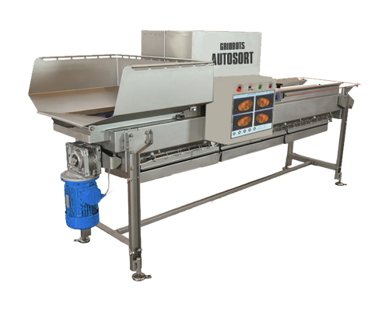
Existing Solutions
1. Gridbots Autosort
Gridbots Autosort is a realtime 360 degree sorting and grading system which can sort more than 500,000 items per hour.. AutoSort uses advance machine vision algorithms to sort items like fruits, vegetables, cashews, potatoes, chips, french fries, potato flakes, dehydrated vegetables or Individual Quick Frozen (IQF) foods such as carrots or peas at very high speeds .
DIS ADVANTAGES:
It is very expensive
Requires high maintenance
Not available in India
Difficult to use

Slide 10
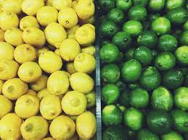
Lemon sorter
A sorter which can segregate the fruits based on their colour. It is a automated sorting machine in which the fruits are identifies by the TCS3200 colour sensor and then it can be separated
By separating the fruits into two divisons we can know whether they are ripen or not .
Disadvantages :
Only one fruit sorter machine
Used in large scale industries

Slide 11
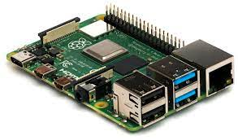
COMPONENTS :
RASPBERRY PI :
The Raspberry Pi is a low cost, credit-card sized computer that plugs into a computer monitor or TV, and uses a standard keyboard and mouse.

Slide 12
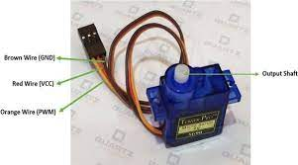
SERVO MOTOR
A servomotor is a rotary actuator or linear actuator that allows for precise control of angular or linear position, velocity and acceleration. It consists of a suitable motor coupled to a sensor for position feedback. It also requires a relatively sophisticated controller, often a dedicated module designed specifically for use with servomotors.
Servomotors are not a specific class of motor, although the term servomotor is often used to refer to a motor suitable for use in a closed loop system.

Slide 13
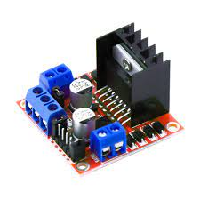
L298N MOTOR DRIVER
This L298N Based Motor Driver Module is a high power motor driver perfect for driving DC Motors and Stepper Motors. It uses the popular L298 motor driver IC and has the onboard 5V regulator which it can supply to an external circuit. It can control up to 4 DC motors, or 2 DC motors with directional and speed control

Slide 14
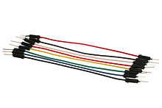
JUMPER WIRES
A jump wire (also known as jumper, jumper wire, jumper cable, DuPont wire or cable) is an electrical wire, or group of them in a cable, with a connector or pin at each end (or sometimes without them – simply "tinned"), which is normally used to interconnect the components of a bread board or other prototype or test circuit, internally or with other equipment or components, without soldering.
Individual jump wires are fitted by inserting their "end connectors" into the slots provided in a breadboard, the header connector of a circuit board, or a piece of test equipment.

Slide 15
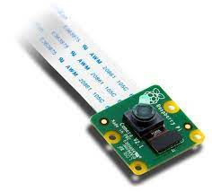
RASPBERRY PI CAMERA
Raspberry Pi as a security camera, webcam server, and even a simple time-lapse creation device. Most of these projects make use of the official Pi camera rather than just a standard USB camera.
The Raspberry Pi Camera Board Features:5MP Omni vision 5647 Camera Module. Still Picture Resolution: 2592 x 1944. Video: Supports 1080p @ 30fps, 720p @ 60fps and 640x480p 60/90 Recording. 15-pin MIPI Camera Serial Interface - Plugs Directly into the Raspberry Pi Board.

Slide 16
PROPOSED SOLUTION :
In this section, we compare the most common methods used for fruit and fruit disease recognition. Figure shows the flow diagram of these methods, which operate in two phases: training and testing. Both require some pre-processing (i.e., image and defect segmentation and feature extraction). In comparison, the system works in three steps. For fruit recognition, fruit images are first segmented into foreground and background. For fruit disease recognition, infected fruit parts are segmented from the image of the diseased fruit. In both cases, the features of the images are then extracted. Finally, a multi-class support vector machine (MSVM) is trained to classify fruits and vegetables into one of the classes and recognize fruit diseases.

Slide 17
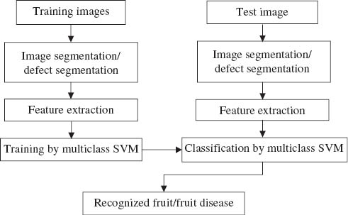

Slide 18
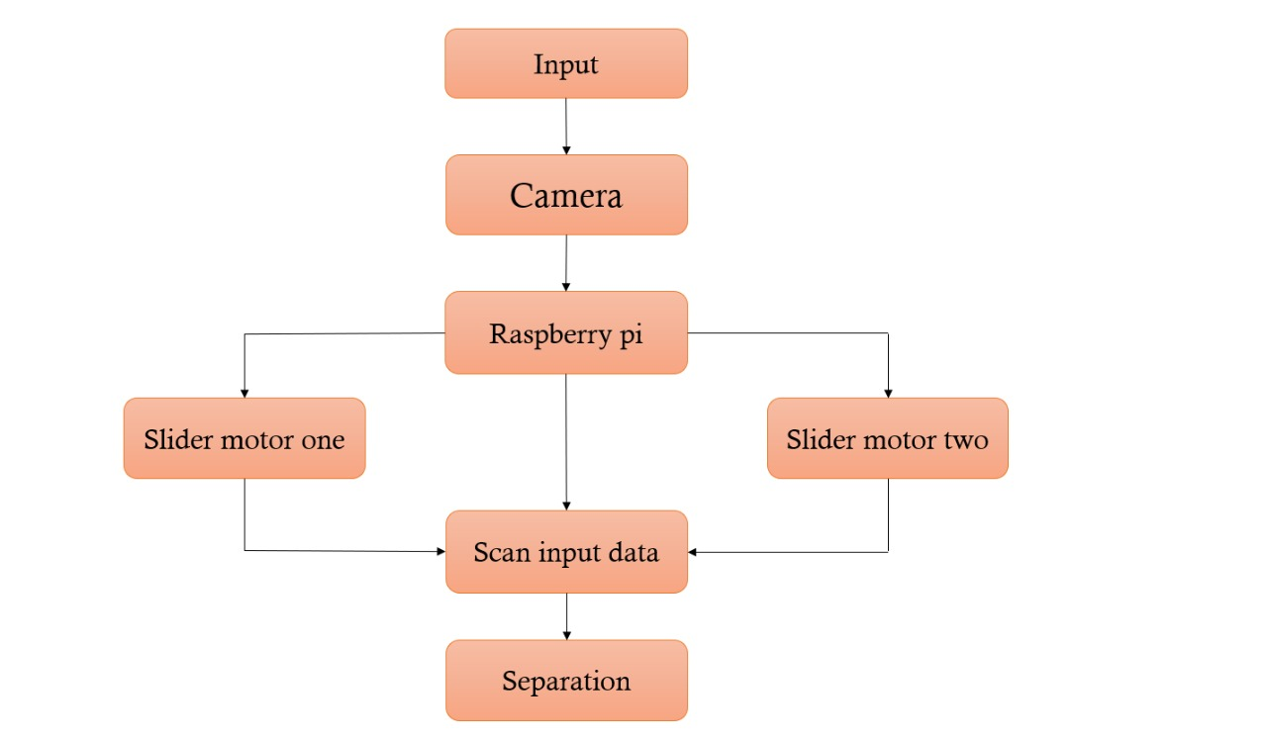
Block diagram

Slide 19
Advantages
The fruit sorting machine can protect the legitimate rights and interests of fruit consumers and reduce the trouble in the process of purchasing. After the fruits are classified according to the national standards, the price can be determined by quality, which saves consumers' purchasing time and reduces the possibility of consumers being cheated.
the picked fruits are not graded, the overall quality of fruits will become worse so it is useful to classify .

Slide 20
Application
This system can be used in food industry
It is also for agriculture use in small as well as lager scale
It can be used for different agriculture products like lemon, tomato, orange, apple, mandarin.

